Slide 1

Fiscal Year 2022 NY State Budget Analysis
&Nonprofit Advocacy Forum
www.npwestchester.org

Slide 2
Our Mission
To strengthen the
visibility, capacity and impact
of the nonprofit sector in Westchester
Child Care | Youth Development | Home Care
Healthcare | Older Adults | Behavioral Health
Substance Misuse | Hunger, Food Insecurity and Distribution
Advocacy | Housing, Affordable Housing, Homelessness
Domestic Violence |Immigrant Rights | LGBTQIA
Physical, Intellectual, Developmental Disabilities
Workforce Development | Community Development
Economic Development | Arts & Culture
Racial Equity |Equity, Diversity & Inclusion
Cancer Care and other Support Groups and Services
Westchester’s Only Business Membership Organization
Solely Dedicated to Advancing the Needs of
Westchester’s Nonprofit Sector,
the People We Serve and the Nonprofit Workforce.
www.npwestchester.org

Slide 3

Fiscal Year 2022 NY State Budget Analysis
9:00 AM – 10:00 AM
Patrick Orecki,
Senior Research Associate, Citizens Budget Commission
Facilitated by Kathy Halas, Executive Director, Child Care Council of Westchester

Slide 4
NPW 2021 Advocacy and Policy Agenda
10:00 AM – 10:45 AM
Update on NPW Advocacy and Policy Priority Areas
Legislative Items
What is Happening in Our Local Westchester Communities
Facilitated by Tom Gabriel,
President and CEO, United Way Westchester and Putnam

Slide 5
  WHAT MATTERS
  10:45 AM – 11:15 AM
  TO YOUR ORGANIZATIONS?
  TO THE PEOPLE AND POPULATIONS YOU SERVE?
  TO YOUR WORKFORCE?
NPW Member Agencies
Facilitated by Tom Gabriel,
President and CEO, United Way Westchester and Putnam

Slide 6
The Citizens Budget Commission (CBC) is a nonpartisan, nonprofit civic organization whose mission is to achieve constructive change in the finances and services of New York City and New York State government. Our mission is rooted in serving the citizenry at large, rather than narrow special interests; preserving public resources, whether financial or human; and focusing on the well-being of future New Yorkers, the most underrepresented group in city and state government.

Slide 7
NPW 2021 Advocacy and Policy Agenda
FOCUS ISSUES
Hunger and Food Insecurity
Homelessness Prevention and Affordable Housing
Health
Immigrant Rights
Youth Safety, Well-being and Education
Report on COVID-19 Vaccine Equity

Slide 8


Hunger and
Food Insecurity
Karen C. Erren
President and CEO
Feeding Westchester
Esmeralda Hoscoy
Westchester Regional Director
Catholic Charities Community Services

Slide 9
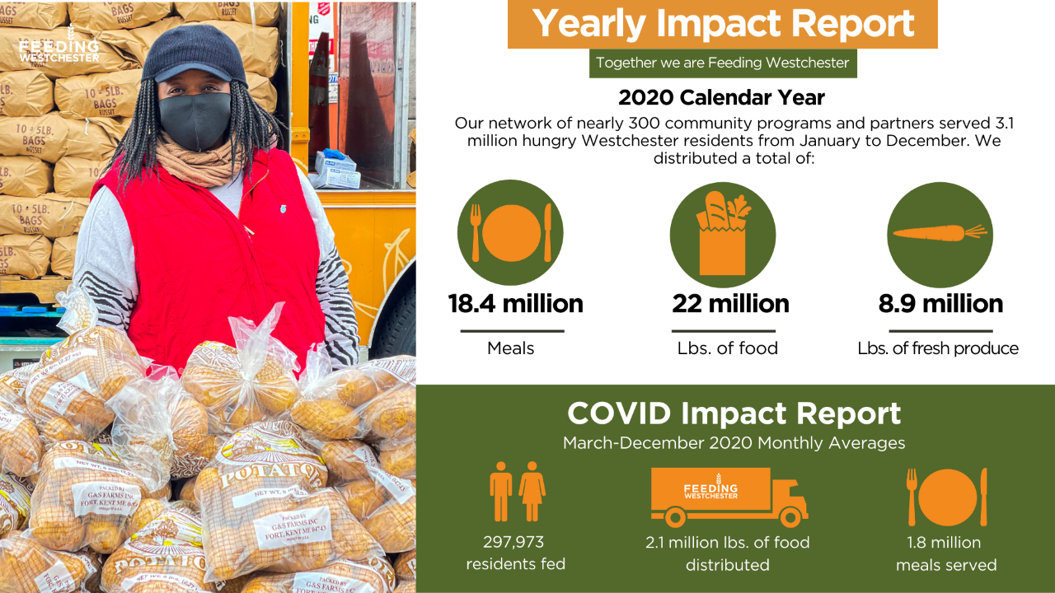

Slide 11

Homelessness Prevention
& Affordable Housing
Cynthis Knox
CEO
CHHOP (Caring for the Hungry & Homeless of Peekskill)
Anahaita Kotval
CEO
Lifting Up Westchester
Rich Nightingale
President & CEO
Westhab, Inc.

Slide 12
Funding for Affordable Housing
Westchester Housing Needs Assessment
Of the 345,000 total housing units in Westchester:
  141,000 or 41% are paying more than 30% of their income towards housing
The need for affordable housing is 82,000 units.
  Including the creation of 11,700 new units.

Slide 13
Funding for Affordable Housing
Supportive Housing for the Formerly Homeless
CAPITAL FUNDING FOR YEAR 6 OF THE GOVERNORS 20K UNIT/15 YEAR SUPPORTIVE HOUSING COMMITMENT - $250 MILLION
CAPITAL FUNDING FOR THE HOMELESS HOUSING ASSISTANCE PROGRAM - $128 MILLION (includes $64M toward 20k commitment above)
ADDITION OF $60 MILLION FOR THE OFFICE OF MENTAL HEALTH CAPITAL PRESERVATION PROGRAM
PRESERVATION OF $20 MILLION TO OMH HOUSING BUDGET
ADDITION OF $2.54 MILLION TO THE HOMELESS HOUSING PREVENTITIVE SERVICES (HHPS) PROGRAM
CODIFY SALES TAX EXEMPTIONS FOR AFFORDABLE HOUSING
Aligned with the Supportive Housing Network of New York

Slide 14

Health
Marie Considine
Executive Director
NAMI Westchester
(National Alliance on Mental Illness)
Judith Watson
CEO
Mount Vernon Neighborhood Health Center, Inc.

Slide 15


“Without mental health, there can be no true physical health.”
– Dr. Brock Chisholm, the first Director-General of the World Health Organization (WHO)
www.mvnhc.org
Judith Watson RN, BSN , MPH, Chief Executive Officer
Mount Vernon neighborhood Health Center, Inc. operates three community health centers, a homeless shelter health clinic, and two school-based health centers in Westchester County. The mission of MVNHC is to extend equally to all, regardless of their ability to pay, comprehensive health services of the highest quality in an atmosphere of humane care, dignity and respect; to promote and protect, as both innovator and advocate, the health and well-being of our clients, patients and members of our surrounding communities; and to join with other health workers, agencies and with communities in a partnership which will enable our organization to promote and protect the total physical, mental and social health and well-being of the people.
www.namiwestchester.org
Marie Considine, MPA, Executive Director
NAMI Westchester is an affiliate of the National Alliance on Mental Illness. We educate, advocate and support mental health for all, through educational programs for peers, parents and families as well as in-school programs for youth. Support groups provide hope and community presentations spread awareness. We are a grassroots organization dedicated to improving the quality of life for all individuals and families whose lives are affected by mental illness and co-occurring disorders. NAMI advocates for access to services, treatment, support and research and is steadfast in its commitment to raise awareness and build a community of hope for all those in need. We offer the kind of understanding and care that only those who have lived the experience of mental illness can provide.

Slide 16

Immigrant Rights
Carola Bracco
Executive Director
Neighbors Link
Jirandy Martinez
Executive Director
Community Resource Center

Slide 17


Youth Safety,
Well-being and Education
Josh Prywes
Program and Policy Manager
Westchester Children’s Association
Kathy Halas
Executive Director
Child Care Council of Westchester, Inc.
Henry Wilson
Executive Director
Youth Community Outreach Program -Y-COP
Donnovan Beckford
CEO/Executive Director
WestCOP

Slide 18
ADDITIONAL INFORMATION AND MATERIALS
Disclaimer
The materials presented in the following slides are provided by NPW Member Organizations and do not necessarily reflect NPW endorsements related to policy and legislative action items.

Slide 20
WESTCHESTER CHILDREN’S ASSOCIATION
Pass the Child Poverty Reduction Act (S.2755/A.1160)
Ensure all students and families have appropriate access to remote learning tools, trainings and resources
Support a broader youth justice agenda
Pass the Solutions Not Suspensions Act and curb the serious racial inequities of school discipline
Expand maternal, infant, and early childhood home visiting (MIECHV)
Restore and maintain childcare, afterschool, and youth development funding
Improve supports for family-based foster care and for youth aging out of care

Slide 21
CHILD CARE COUNCIL OF WESTCHESTER
Significant child care relief – an estimated nearly $450 million – is on its way to New York.
But in order to ensure children and parents have reliable child care, and essential child care providers can continue to provide safe, quality care to young children, we need to improve the distribution of funds.
“It is critical that the new funding be deployed swiftly and with a more comprehensive and integrated strategy than was realized with CARES, one that is sensitive to both statewide imperatives as well as local needs and capacities. Along with many statewide advocates, we believe the best way to accomplish this is for OCFS to rely on its existing child care subsidy system structure and grant these funds to the 58 Social Services Districts in the state. Specifically, OCFS should require counties to declare an intention to spend the funds on the child care system in their communities within certain parameters, and explicitly indicate the purposes the funds will be used for. Then OCFS should quickly distribute the funds proportionally using the existing subsidy allocations as a model.”

Slide 24
CATHOLIC CHARITIES

Slide 25
CATHOLIC CHARITIES

