Slide 1
MENTAL HEALTH MATTERS
June 4, 2020
Michael Orth, MSW, Commissioner, Westchester County Department of Community Mental Health
Bernadette Kingham-Bez, SVP, St. Joseph’s Hospital and Executive Director of St. Vincent’s Hospital Westchester
Dr. Adwoa Akhu, Licensed Clinical Psychologist, Twenty years in Private Practice and former president of the New York Association of Black Psychologists
Anahaita Kotval, President, Nonprofit Westchester, CEO, Lifting Up Westchester

Slide 2
MENTAL HEALTH MATTERS
DATA
What Does Historical Data and the Current Experiences of Behavioral Health Experts Tell Us?
ISSUES TO BE ADDRESSED
What are the Behavioral Health Supports that Staff Need?
What are the Issues that Employers Need to Recognize?
What Can Employers Do to Support a Healthy Work Environment
FRAMEWORK
Education
Prevention
Intervention
Resources
LOGOS Here
Series Sponsor

Slide 4
Our Mission To strengthen the visibility, capacity and impact of the nonprofit sector in Westchester for a more just and caring community.

Slide 5
TIME TO BREATH

Slide 6
A True Public Health Emergency
- Traffic accidents 36,120 deaths in 2019
- Firearms killed 39,7732 in 2018 –23,854 firearms suicide
- 42,170 women died of breast cancer in 2019

Slide 7
(1) Fear of the virus itself, the unknown, absence of vaccine, & death.
(2) Secondary challenges: isolation economic impact of lost income, loss of jobs, food insecurities/hunger, change in routines, working remotely (school & work) all which can lead to anxiety, depression, agitation, violence, lack of sleep, & self-medication.
DATA-Double Impact COVID-19

Slide 8
More than half of Americans report the coronavirus crisis harming mental health and experiencing distress.
A federal emergency hotline for people in emotional distress registered a more that 1,000% increase in April (from previous years)
During the 2008 financial crisis, a study found that for every percentage point increase in the unemployment rate, there was about a 1.6% increase in the suicide rate. And now we’re looking at almost 30 million people, unemployed in the USA.
While the rates of behavioral health disorders may not significantly differ from the general population, Blacks & Latinos have substantially lower access to mental health & substance-misuse treatment services (NSDUH, 2020).
DATA

Slide 9
SUPPORTING WORKPLACE HEALTH & WELLNESS
What are the opportunities for businesses to both ensure productivity and be part of the social safety net?
How do for-profit businesses, government, nonprofits/healthcare work together?

Slide 10
Supporting Workplace Health & Wellness Framework: Examples
Education
Post Personal protective equipment (PPE) reminders and protocols throughout office.
Post wellness and positive messaging around office space.
Provide “Mental Health First Aid” (or other) training for staff.
Supportive resource list for staff that will not continue to be employed.
Prevention
Upon returning to work after COVID-19, ensure the physical workplace is safe for employees to work in.
Have a meeting with staff before they return to work to discuss safety plans.
Communicate clearly and often with staff.
Create “Break Rooms” in office setting.
Offer mindfulness and wellness opportunities for all staff.
Stay connected with staff. Schedule regular staff meetings, supervision and peer groups.

Slide 11
Supporting Workplace Health & Wellness Framework: Examples
Intervention
Conduct regular “check-ins” with staff on “how are you feeling”.
Create “crisis plan” for workers struggling. Make sure to include concrete protocols.
Address mourning, loss, grief employees maybe experiencing.
Provide a confidential help line or email address where employees can raise concerns and ask for help anonymously.
Resources
Provide resources & supports to staff.
Offer Employee Assistance Program (EAP) if available.
Create partnership with local mental health agencies.

Slide 13
TAKE THE CENSUS
https://planning.westchestergov.com/initiatives/census-2020

Slide 14
PRESIDENTIAL, CONGRESSIONAL, STATE, LOCAL PRIMARIES
JUNE 23
http://www.lwvw.org/
VOTE

Slide 15
Westchester County Department of Community Mental Health (DCMH)
(914) 995-1900
Resource Directory (You had directly)
http://mentalhealth.westchestergov.com
Tips to Help Cope During the COVID-19 Pandemic https://mentalhealth.westchestergov.com/tips-to-help-cope
NY State Department of Health
https://coronavirus.health.ny.gov/home
RESOURCES

Slide 16
OMH NYS COVID-19 Emotional Support Line
(844) 863-9314
St Vincent’s Crisis Prevention & Response Team
(914) 925-5959
National Suicide Prevention Lifeline
1-800-273-TALK (8255)
New York State Domestic Violence Hotline
1-800-942-6906
Crisis Text Line
Text "Got5" to 741-741
RESOURCES

Slide 17
CCLEAN
JOE PIZZIMENTI, OWNER
914-340-0220
WWW.CLEAN.IT

Slide 18
CONTACT
Nonprofit Westchester
www.npwestchester.org,
Jan Fisher
Executive Director
jfisher@npwestchester.org, 914-439-0203
Suzanne Gardos
Manager, Community Engagement
sgardos@npwestchester.org, 914-332-6679

Slide 19
Questions
??? ??? ??? ???

Slide 20
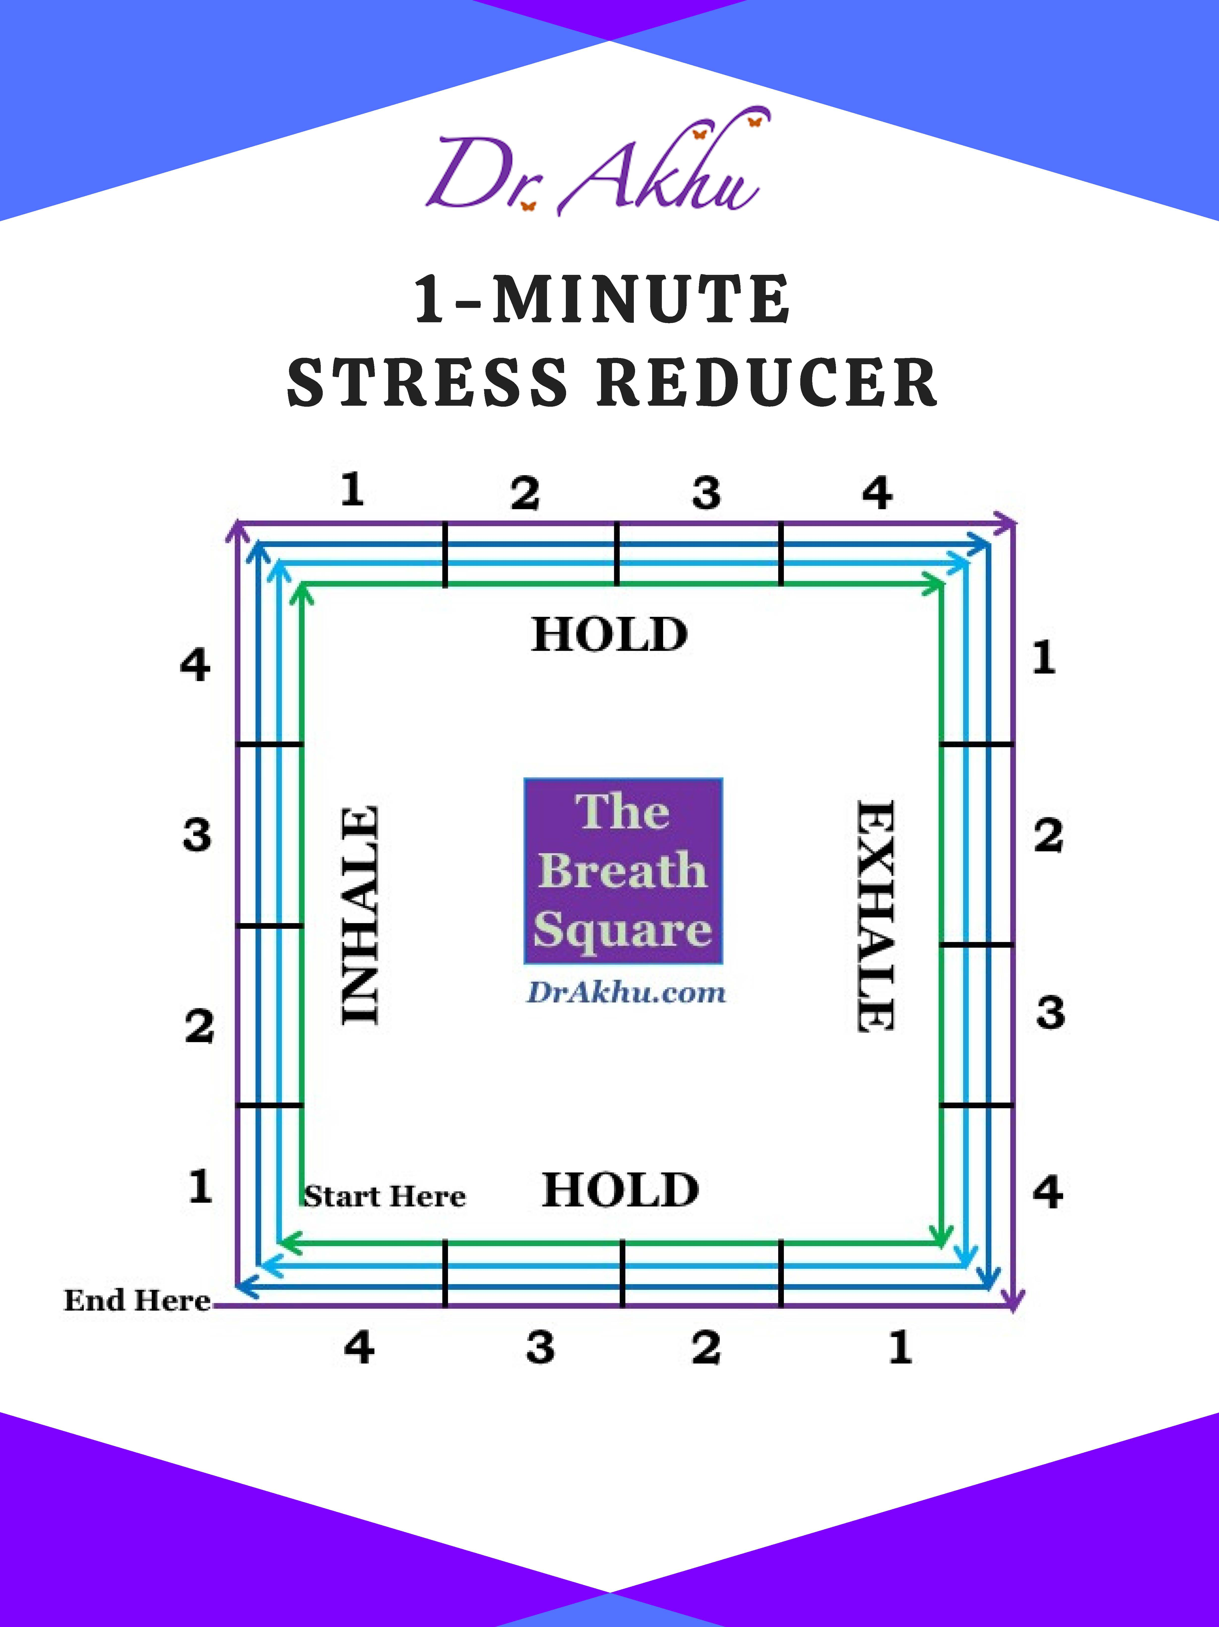

Slide 21
TIME TO BREATH

Slide 22
THANK YOU

